Slide 1
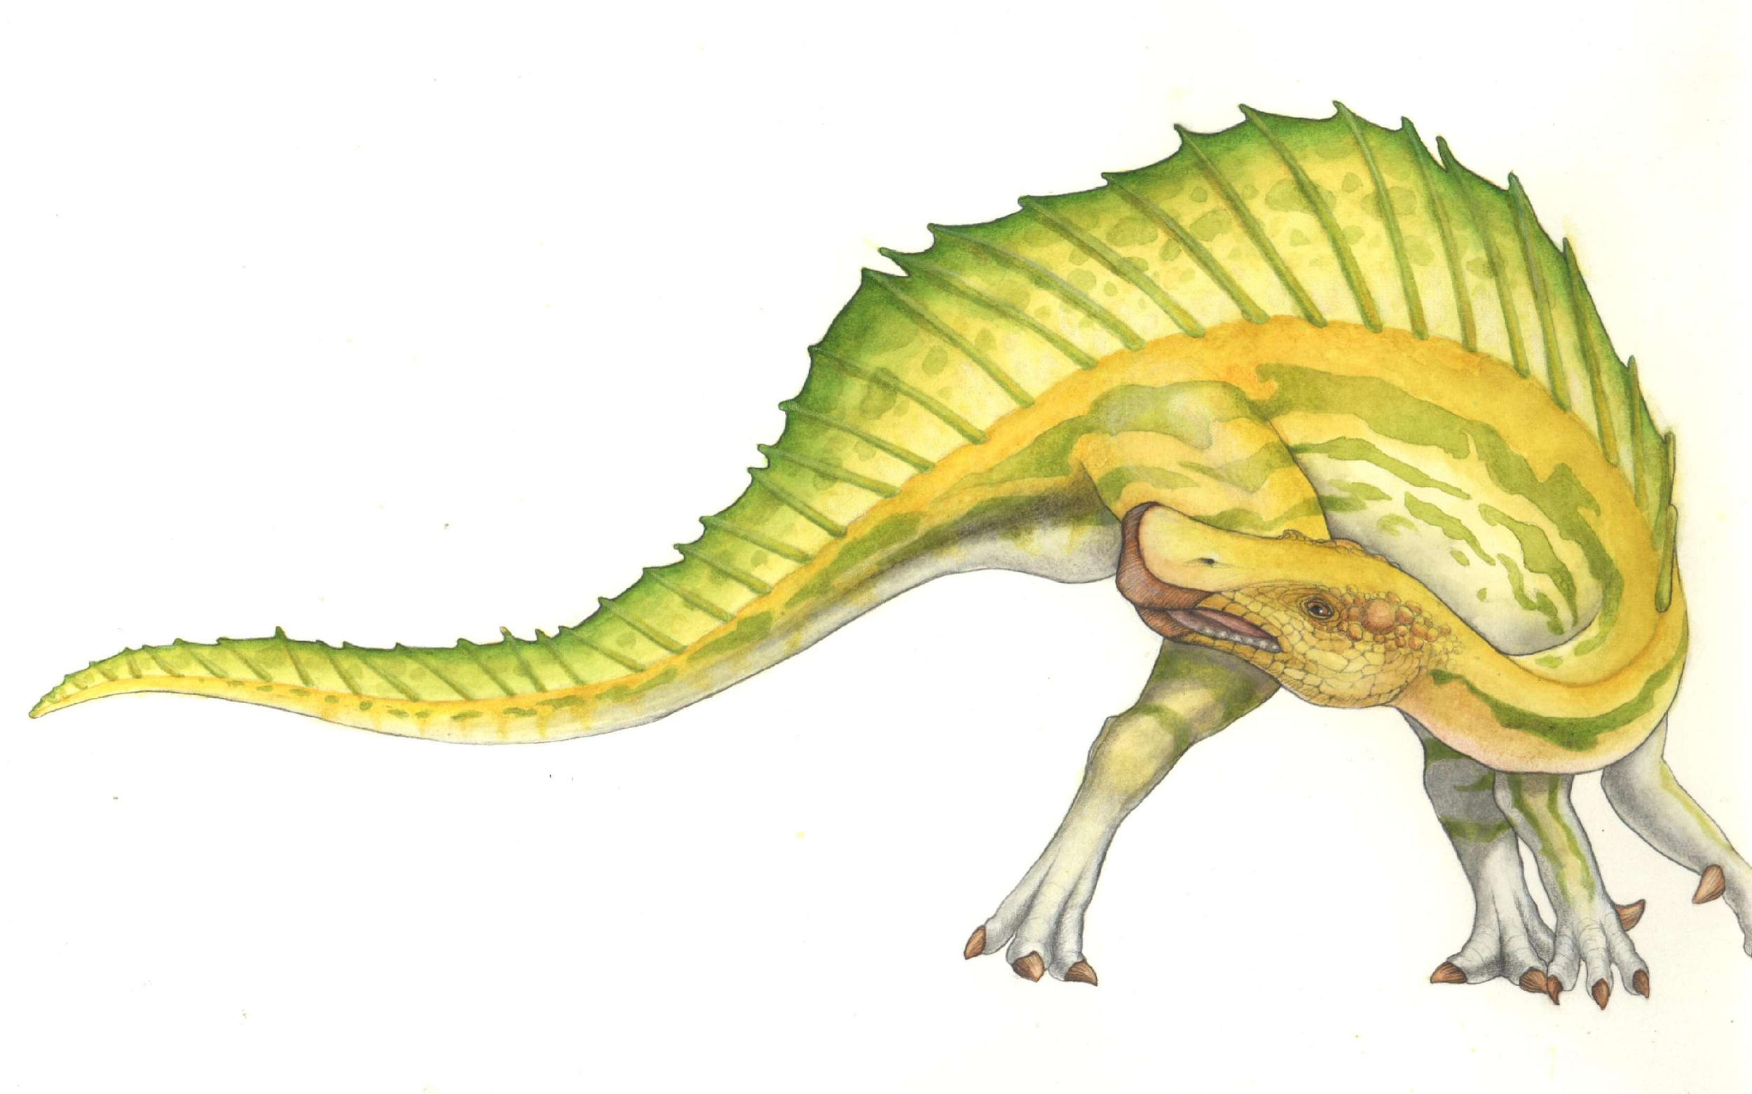
Operating Systems BDS-5A
Lecture 1
Date: 21-08-2023
Introduction

Slide 2
Myself
RUBAB ANAM JANJUA
Email: rubab.anam@nu.edu.pk
Office Num: E-229
FAST School of Computing, FAST-NUCES, Lahore.

Slide 3
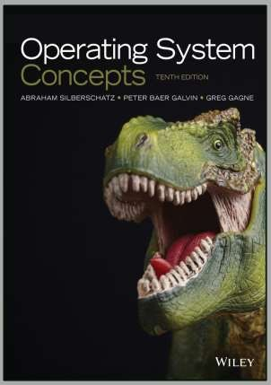
Books and Resources
● Operating System Concepts 10th Edition by Silberschatz, Galvin and Gagne

Slide 4
Course outline
Introduction
Processes, Inter-process communication,
Threads
Synchronization, Semaphores,
Deadlocks
CPU Scheduling
Memory management
File-system management
 ……

Slide 5

OS
Overview

Slide 6
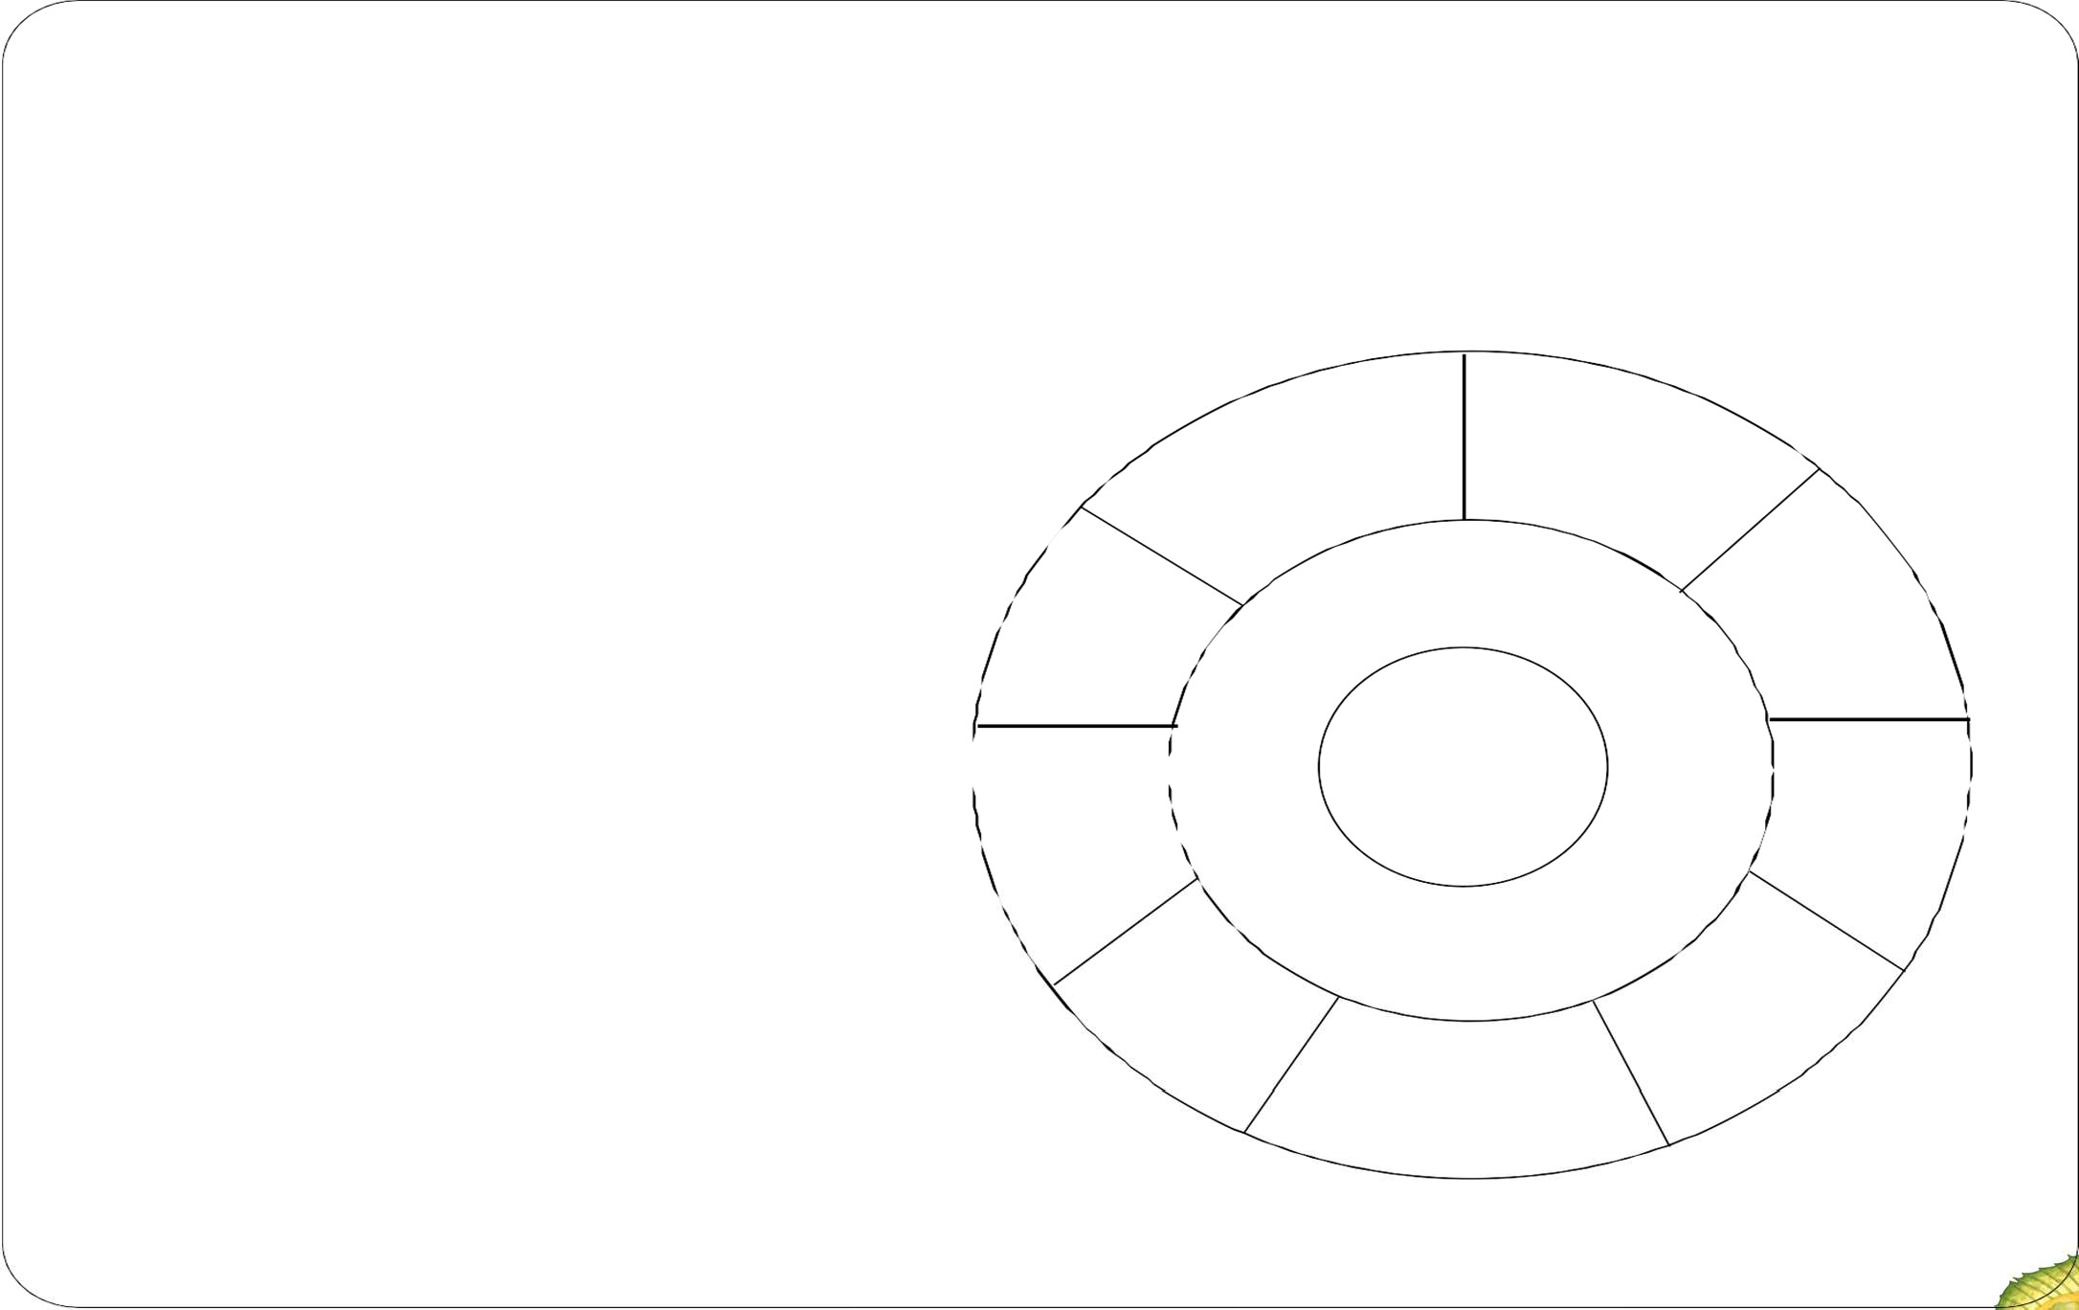
The Operating System controls the machine
gcc
gdb
User
Application
Operating System
Hardware
OS Kernel
grep
diff
Hard ware
vi
date
xterm
emacs netscape

Slide 7

A better picture
many applications
Application
One Operating System
One Hardware
System calls
Operating System
Privileged instructions
Machine instructions
Hardware

Slide 8
Operating System in Action
OS is a program, just like any other program
When you turn power on, bootstrap program is loaded from ROM
Bootstrap program
Examine/check machine configuration
# CPUs
How much memory
# and type of HW devices
Build configuration structure describing the HW
Locates and Loads the OS
The control transfers to the OS

Slide 9
Operating System in Action
Operating System:
Initialize kernel data structures
Initialize state of HW devices
Creates a number of processes to start operation

Slide 10
References
Operating System Concepts 8/9th Ed Chapter 1
Modern Operating Systems 3rd Ed Chapter 1
Operating Systems 6th Ed Chapter 2
 By William Stalling
http://en.wikipedia.org/wiki/Time-sharing
http://en.wikipedia.org/wiki/Operating_system
http://en.wikipedia.org/wiki/Distributed_computing

Slide 11
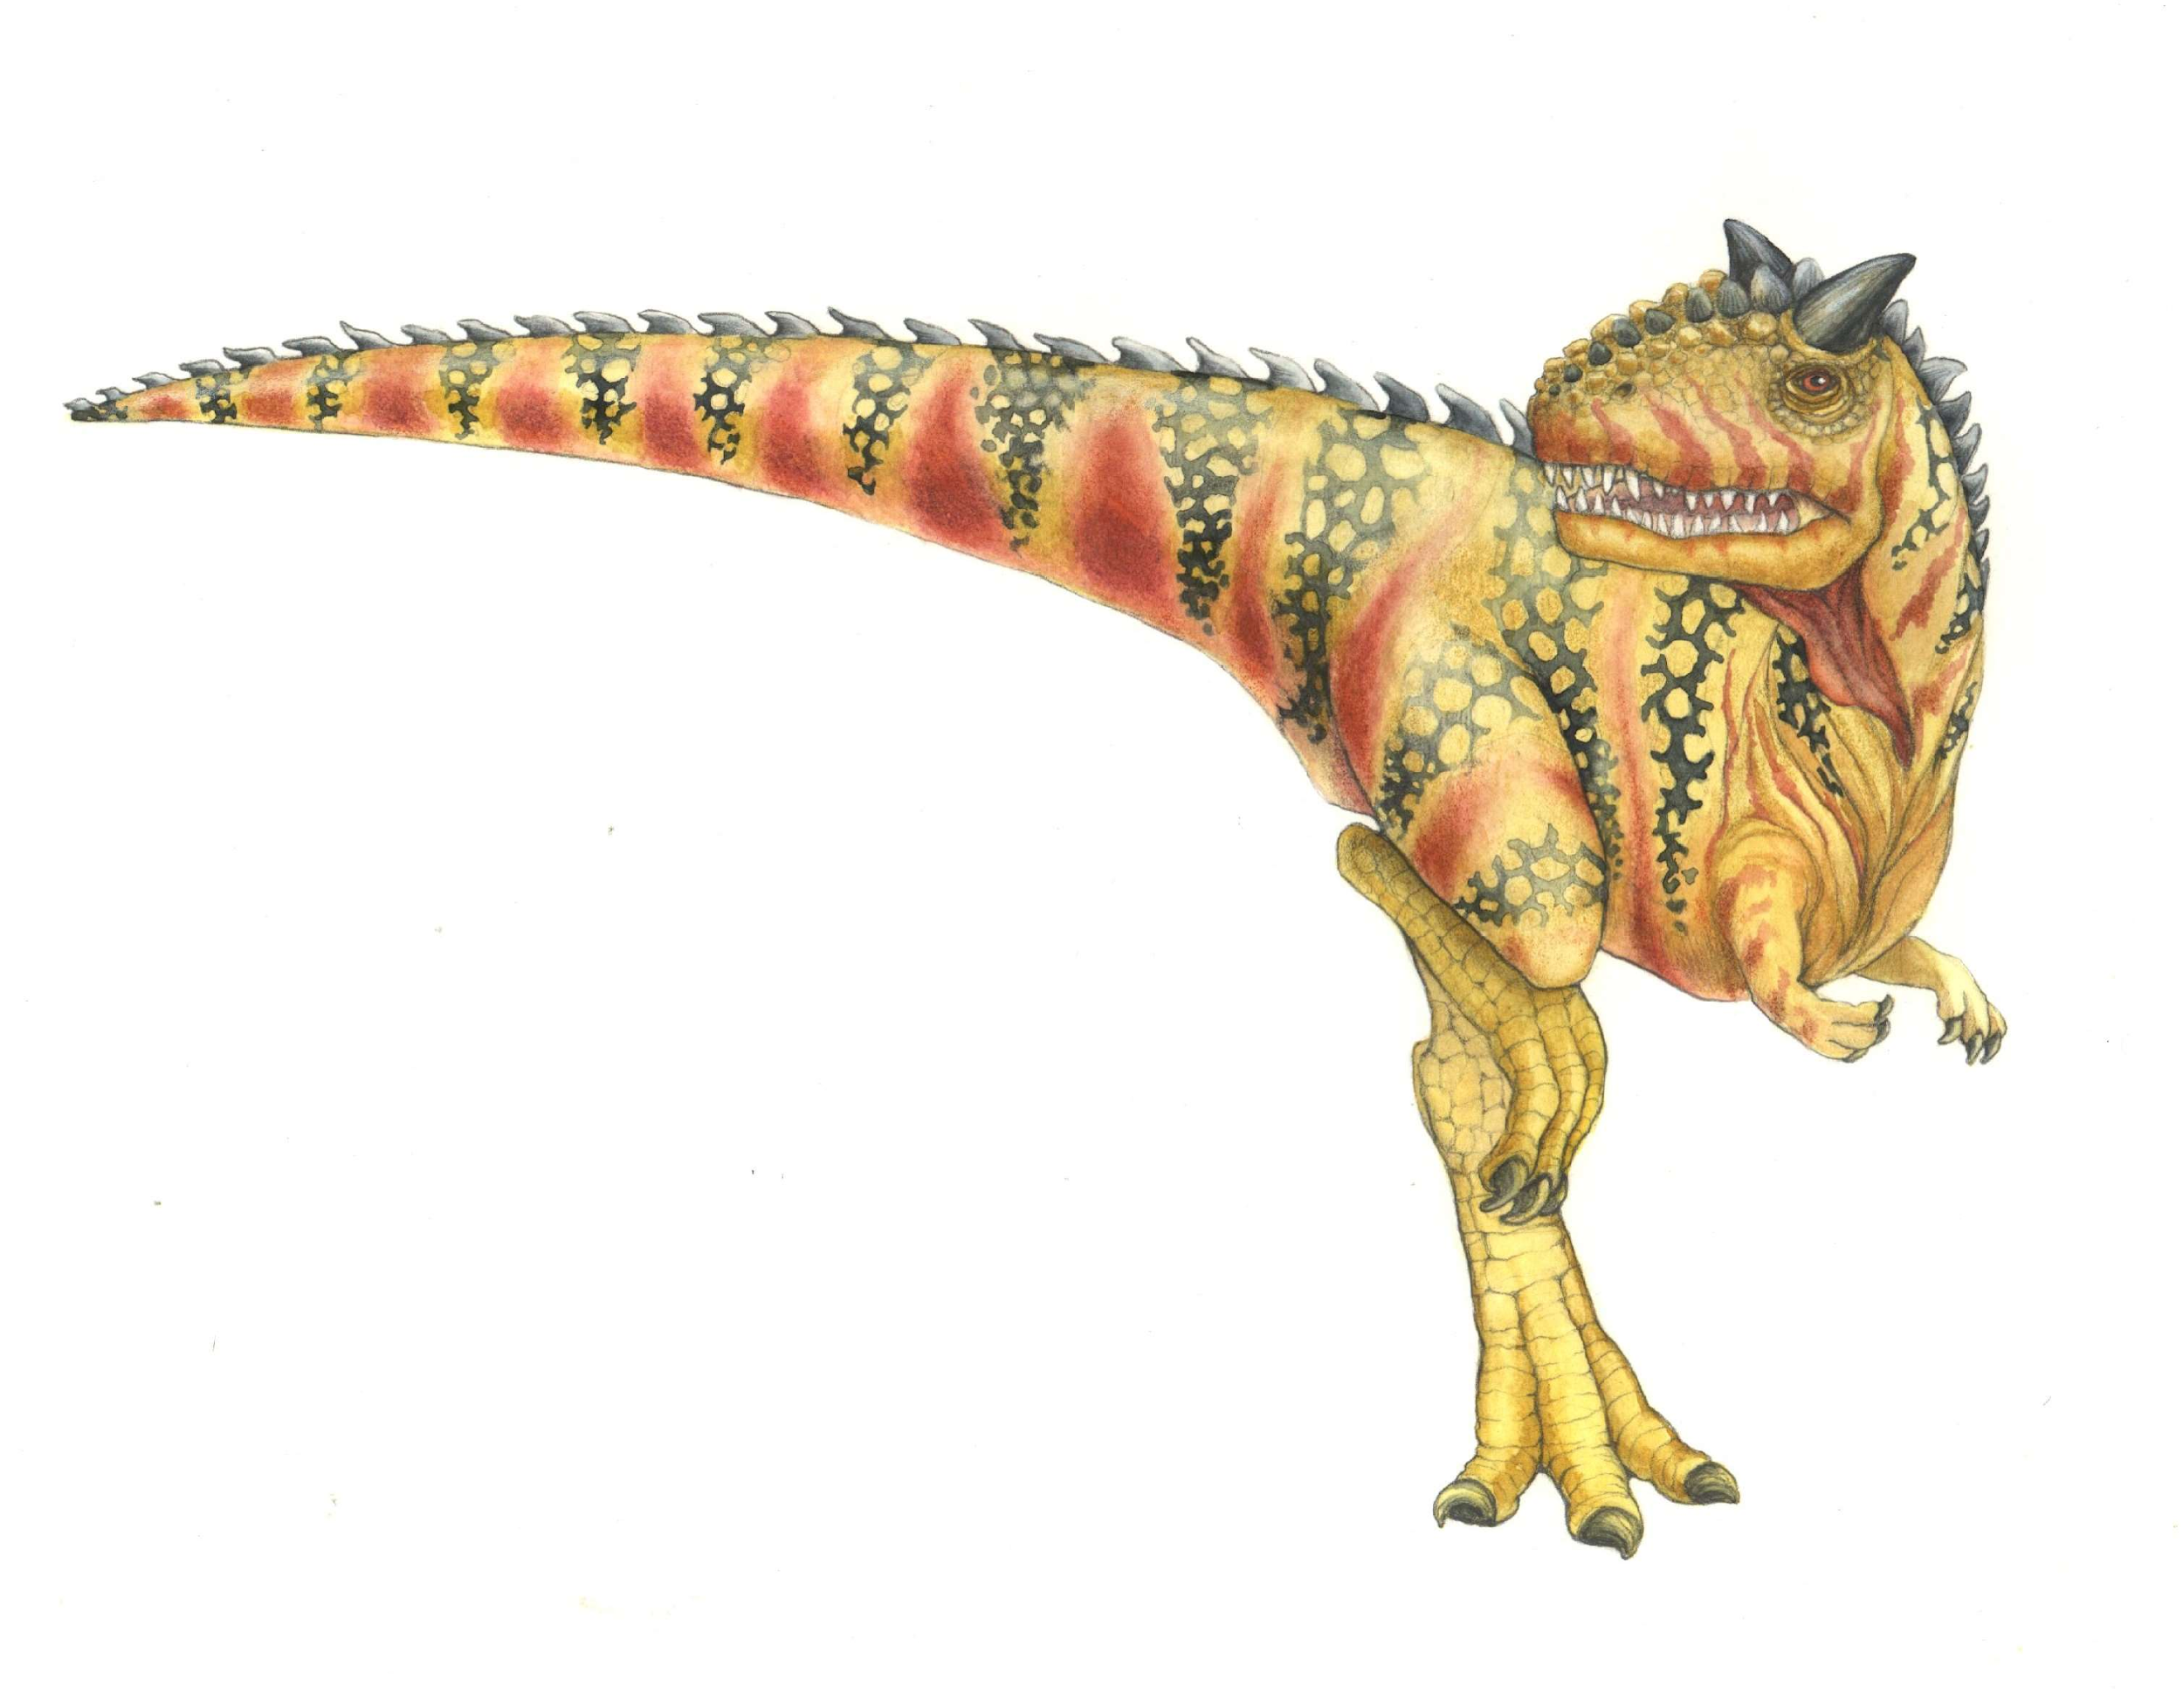
End
Operating System Concepts – 10^{h} Edition

